Slide 1
Unit 3

Slide 2
Unit 3 Krugman Book Modules
3.1 Aggregate Demand (AD) Module 17
3.2 Multipliers Module 16 Module 21
3.3 Short-Run Aggregate Supply (SRAS) Module 18
3.4 Long-Run Aggregate Supply (LRAS) Module 18
3.5 Equilibrium in the Aggregate Demand–Aggregate Supply (AD–AS) Model Module 19
3.6 Changes in the AD–AS Model in the Short Run Module 19
3.7 Long-Run Self-Adjustment Module 18
3.8 Fiscal Policy Module 20 Module 21
3.9 Automatic Stabilizers Module 21

Slide 3
AD SRAS Summary
Aggregate Demand
Short Run Aggregate Supply

Slide 4
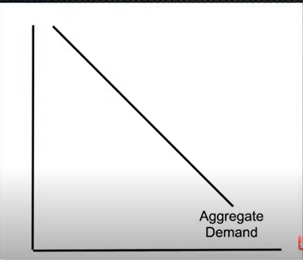
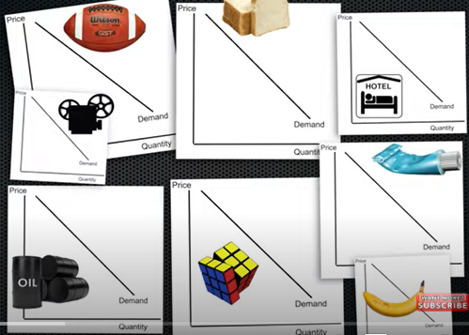



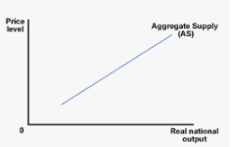




Aggregate Demand
Short Run Aggregate Supply (SRAS)
Short Run Aggregate Supply

Slide 5
AD = C + I + G + (X-M)
Government Spending
Exports
(Foreigners buying from locals)
Imports
(locals buying from foreigners)
Consumption
Investment (by firms)

Slide 6

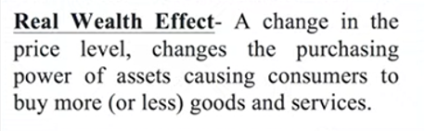

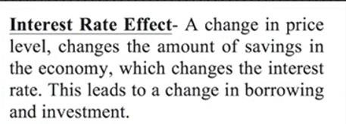

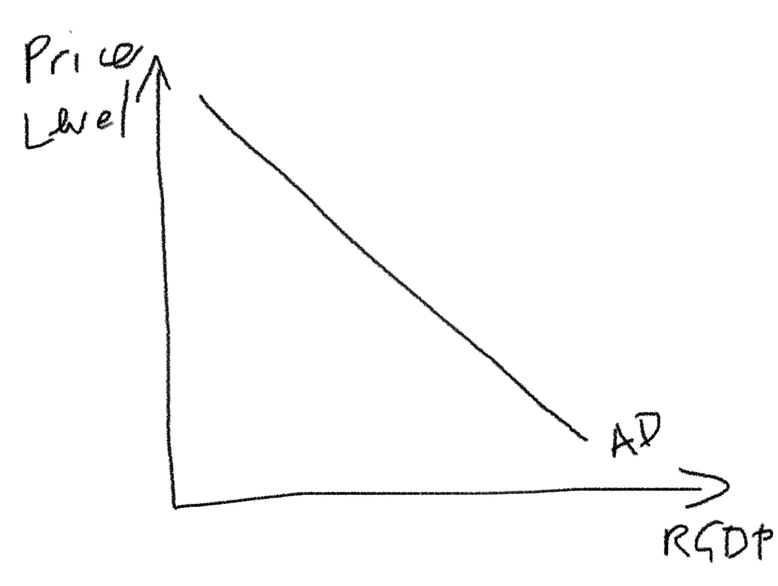
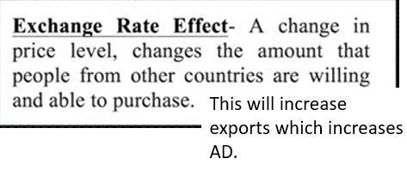

Why the AD curve slopes down
Note: This is the main reason and the other two are minor reasons.
AD follows the law of demand; it is downward sloping.
We should learn the three reasons that explain its slope (just as we did for the micro demand curve).
Foreign Trade Effect

Slide 7
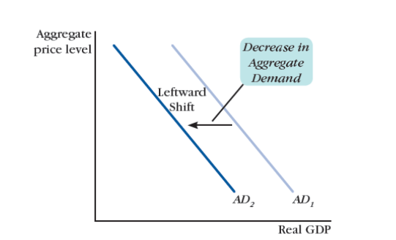
Movement Along AD Curve vs Movement of AD Curve
Whole Economy eg. China
Whole Economy eg. China
Change in price level
Change in other factors (that aren’t price level)

Slide 8
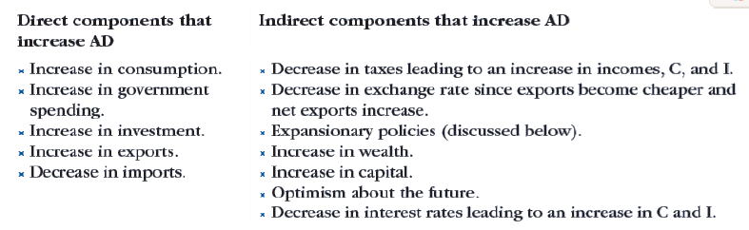
Factors that Shift Aggregate Demand
Whole Economy eg. China
Events that shift the demand curve can be referred to as demand shocks.

Slide 9
Demand Shocks – What will be the effect on AD?
Factor | Increase | Decrease
Any change of C, I, G, X-M | ↑AD – more spending | ↓AD – less spending
Stock market stocks owned by households | ↑AD – consumers are wealthier now | ↓AD – consumers are poorer now
Government purchases | ↑AD – increase government spending | ↓AD – decrease gov spending
Consumer Confidence | ↑AD – consumers will buy more in the future | ↓AD – consumers will buy less
Unemployment | ↓AD – people have less income | ↑AD – people have more income
Technology of Products | ↑AD – consumers are attracted by new products | ↓AD – consumers get less utility from products
Inventory levels and Capital Goods levels | ↓AD – businesses don’t need to invest as much in new inventory | ↑AD – businesses need to buy a lot of new inventory
Price level of another country | ↑AD – foreigners will purchase more of our exports | ↓AD – foreigners will purchase less of our exports
Income of Another Country | ↑AD – foreigners will purchase more of our exports | ↓AD – foreigners will purchase less of our exports

Slide 10
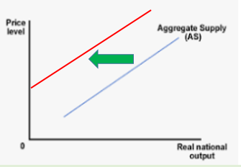
Movement Along AS Curve vs Movement of AS Curve
Short Run Aggregate Supply (SRAS)
Short Run Aggregate Supply (SRAS)
Change in price level
Change in other factors that are not price level

Slide 11
Factors that shift the SRAS Curve
Factor | Increase | Decrease
Commodity Cost | SRAS shifts to the left | SRAS shifts to the right
Nominal Wages | SRAS shifts to the left | SRAS shifts to the right
Productivity | SRAS shifts to the right | SRAS shifts to the left
Price of imported raw materials | SRAS shifts to the left | SRAS shifts to the right
Expectations of Inflation | SRAS shifts to the left (workers ask for higher wages) | SRAS shifts to the right (workers are willing to accept lower wages)
Price of any inputs | SRAS shifts to the left | SRAS shifts to the right

Slide 12




Reasons for Sticky Resource Costs
Sticky Wages – MRU - YouTube
Wage changes =
Labor in particular is sticky which causes price of labor to be slow to adjust for various reasons.
  Contracts. Eg. An employee may have a contract where they are paid 15000 RMB each month that lasts for a year. Even if the price level rises (inflation), they will be locked into that contract.
  Dislike of pay cuts. Workers have an intense psychological dislike for pay cuts and so employers avoid them.
  Efficiency wages – many businesses pay extra to keep quality workers. Therefore they find it harder to pay less because they may lose their best workers.
All of these above factors make the wage less likely to change! Similar logic applies to the other resources.
Note: We sometimes say ‘sticky wages’ in place of ‘sticky resource costs’. Both are explaining that the prices of producer inputs are slower to adjust than other prices.
Summary
Wages and other resource costs resist change and are therefore referred to as ‘sticky’.
LRAS & SRAS

Slide 13
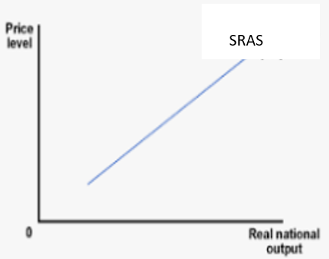
Consequence of Sticky Resource Costs
Let’s assume we have an economy where there is inflation and deflation from time to time.
If the price level changes, businesses change the price of their goods and services.
However, Sticky Resource costs cause the resource prices to stay the same.
When the Price Level Goes Up
Business Revenue = Increase
Business Resource costs = stay the same (eg. Wages, material cost etc.)
This is good for businesses, so they will increase production, increasing GDP.
When the Price Level Goes Down
Business Revenue = Decrease
Business Resource costs = stay the same
This is bad for businesses, so they will decrease production, decreasing GDP.
↑ price level -> ↑ output
↓ price level -> ↓ output
Summary
Sticky wages cause more production when price level increases and less production when price level decreases.
There is a positive relationship between price level and output – so SRAS slopes upward.

Slide 14

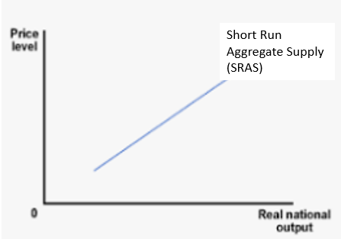
Sticky Wages Summary
Wage changes =
Price of product changes =
and
Upward sloping SRAS curve
Summary
The SRAS slopes up because of sticky wages which makes producers produce more when the price level increases (positive relationship).

Slide 15
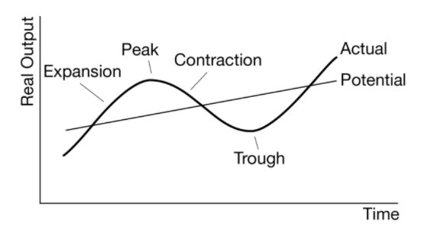
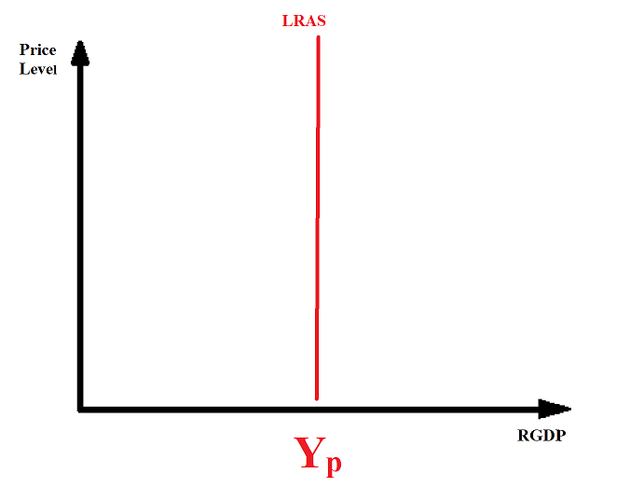
Potential Output and the Business Cycle
Potential Output Y_{P} (also called Full Employment Output, Y_{F} ) can be showed as the LRAS or on the business cycle.
It represents the long run, sustainable level of output.
  This level will increase as we have increases in technology, population, education etc.

Slide 16
Long Run Aggregate Supply Shocks
Supply shocks shift the supply left or right.
Factor | Increase | Decrease
Technology | ↑LRAS, Y_{P} | ↓LRAS, Y_{P}
Education of Workers | ↑LRAS, Y_{P} | ↓LRAS, Y_{P}
Number of machines | ↑LRAS, Y_{P} | ↓LRAS, Y_{P}
Population increase | ↑LRAS, Y_{P} | ↓LRAS, Y_{P}
Discovery of new resources | ↑LRAS, Y_{P} | ↓LRAS, Y_{P}
Climate Change | ↓LRAS, Y_{P} | ↑LRAS, Y_{P}
Long term change to corporate tax | ↓LRAS, Y_{P} | ↑LRAS, Y_{P}
Aging Population | ↓LRAS, Y_{P} | ↑LRAS, Y_{P}
Tax Credits or Subsidies for Investment | ↑LRAS, Y_{P} | ↓LRAS, Y_{P}

Slide 17
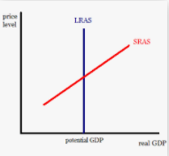
Change in SRAS and LRAS
Summary
Long term factors shift both the SRAS and LRAS.
Short term factors shift only the SRAS.
A change in short run supply factors which are not permanent will change the SRAS only but not LRAS.
A change in long run, permanent factors will change BOTH the SRAS and the LRAS.
Eg. An earthquake causes a decrease in production for a few weeks.
Eg. Education reforms cause large parts of the population to have improved knowledge and skills.
The SRAS will shift to the left, as production is reduced.
LRAS will be unchanged because the situation will soon be resolved.
Both the LRAS and SRAS will increase.

Slide 18
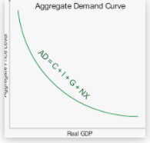
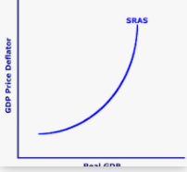
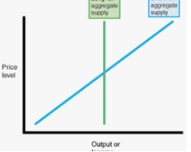
AD, SRAS, LRAS
AD, Aggregate Demand – demand for all goods and services in the economy (Equal to C+I+G+(X-M))
AS, Aggregate Supply – production function of all goods and services in the economy
  SRAS, Short Run Aggregate Supply – production function of all goods and services in the economy in the short run
    Slopes up as a result of sticky wages (price of labor is fixed in the short run)
  LRAS, Long Run Aggregate Supply – production function of all goods and services in the economy in the long run
    This represents the long run productive capacity of the economy
      Things such as technology level, education level, government stability etc. are important for LRAS

Slide 19
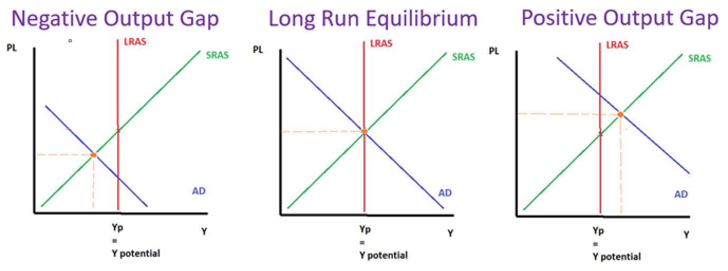
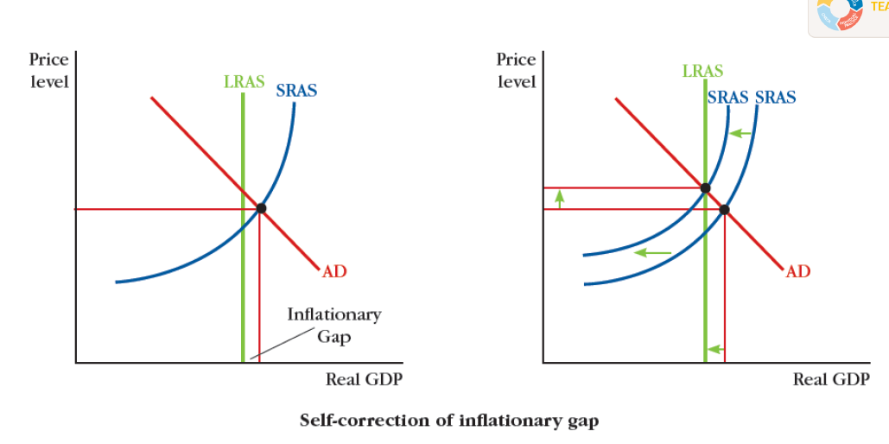
Output Gaps / Equilibrium
Long Run Equilibrium – economy is producing at potential output. (all three curves are in equilibrium)
Negative Output Gap (Recessionary Gap) – economy produces less, caused by a negative AD or SRAS shock.
  Negative SRAS Shock = stagflation
Positive Output Gap (Inflationary Gap) – economy produces more than potential output, caused by a positive AD or SRAS shock.
  Positive AD shock = inflationary gap
    inflation
The economy naturally returns to long run equilibrium.
The SRAS will adjust once the wages become less sticky in the Long Run.
  Recession: price level falls and so employers will eventually lower wages which pushes SRAS to the right
  Overheating: price level increases and so employees ask for higher wages which pushes SRAS to the left

Slide 20
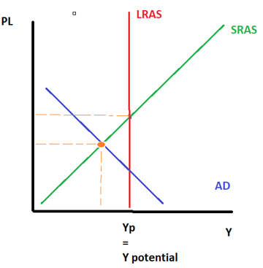
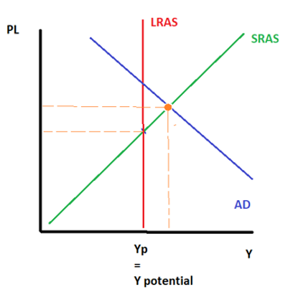
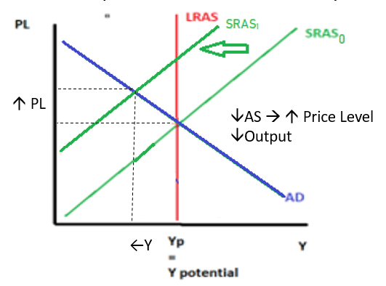
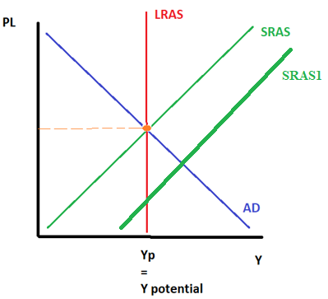
AD/AS Equilibrium Summary
 | Decreases | Increases
AD
SRAS
Negative Output Gap / Recessionary Gap, sometimes called a Deflationary Gap
Positive Output Gap / Inflationary Gap
While output is higher, there are concerns about inflation.
AD₀
AD₁
AD₁
Y_{actual}
This is the ‘classic’ recession situation.
Y_{actual}
Negative Output Gap / Recessionary Gap
Stagflation
Positive Output Gap but NOT Inflationary Gap
There isn’t anything negative about this situation. Output is higher and inflation is under control.
This is arguably the worst situation of all because we have low output and inflation.
Y_{actual}

Slide 21

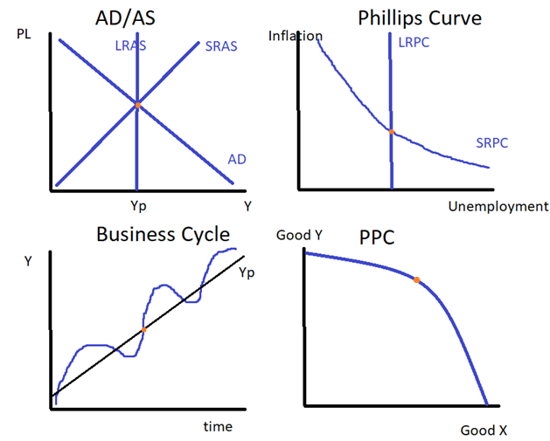
Potential Output/Long Run Equilibrium
The ‘nice, happy’ level of the economy
Actual Output = Potential Output
(NRU = Natural Rate of Unemployment = structural + frictional unemployment)
Actual Unemployment = NRU

Slide 22
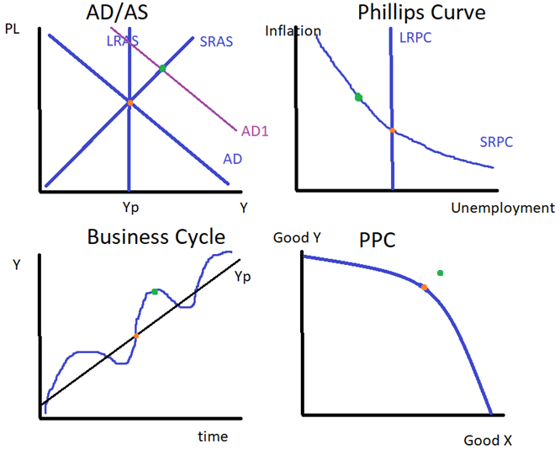
Positive Output Gap/Inflationary Gap
The ‘go go go’ level of the economy
The economy is producing more and there is lower unemployment but prices are going up. We can say the economy is overheating.
Actual Output > Potential Output
Actual Unemployment < NRU

Slide 23
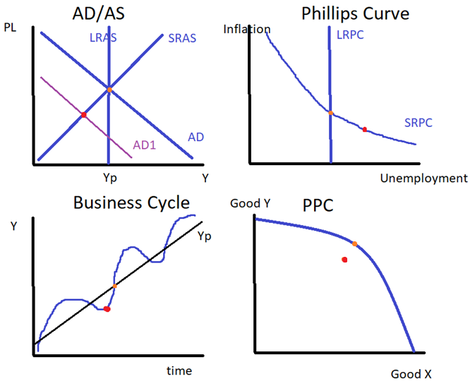
Negative Output Gap/Recessionary Gap
The ‘slowed down’ level of the economy
Actual Output < Potential Output
Note: The AD/AS graph could also show a decrease in the SRAS which would have the same effect.
Actual Unemployment > NRU
We have cyclical unemployment.

Slide 24
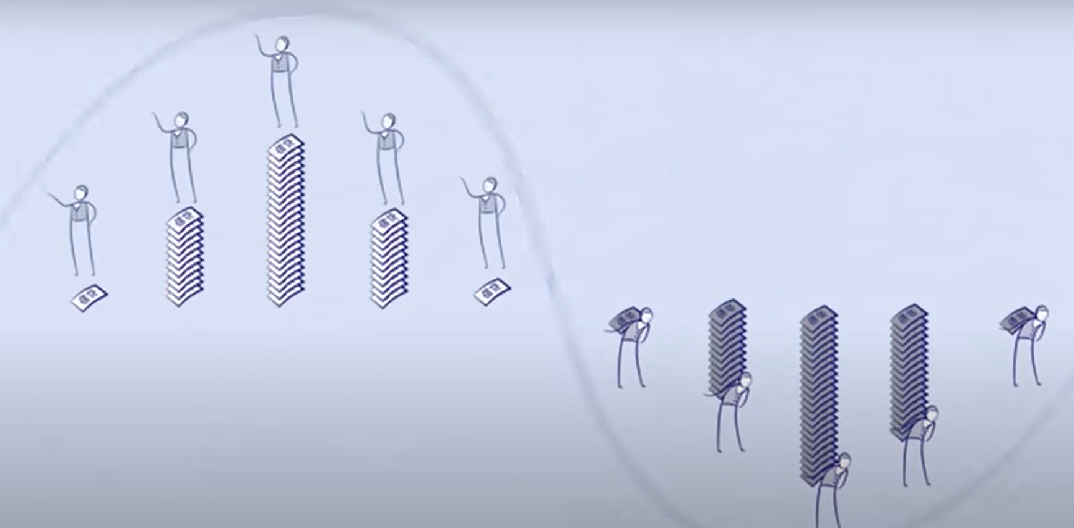
Why are output gaps usually caused by AD shifts?
Chinese
English
In short, because of human nature and our ability to borrow, we tend to consume more now, which means we have to consume less in the future when we pay back our borrowing.
This creates debt cycles.
Summary
When we are asked about output gaps in AP Macro, are default assumption is that they are caused by AD shifting.
This is due to the so called ‘debt cycle’ where we buy now today, but buy less in the future.
AD will be above Y_{p} when we borrow and consume more than we earn.
However in the future, AD will be below Y_{p} when we have to consume less and pay back our loans.

Slide 25
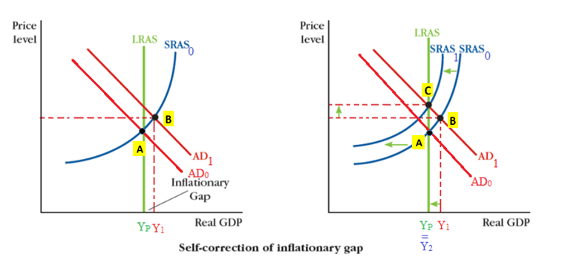
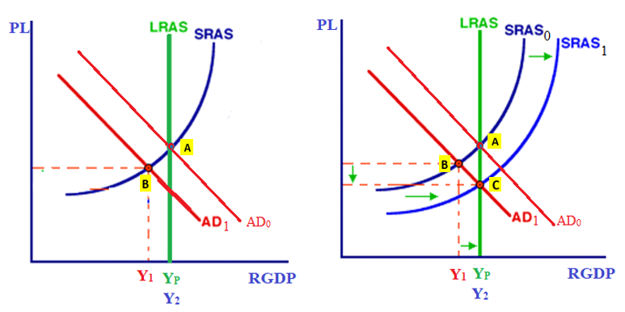
Self Adjustment
The economy self adjusts when SRAS moves, left or right, returning to Y_{P.}
Positive Output Gap (caused by AD increase)
Negative Output Gap (caused by AD decrease)
In response to a positive output gap, where the Price Level has gone up, in the long run, wages will also go up (in the SR they are sticky), causing SRAS to shift left. The economy returns to Y_{p}
In response to a negative output gap, where the Price Level has gone down, in the long run, wages will also go down (in the SR they are sticky), causing SRAS to shift right. The economy returns to Y_{p}

Slide 26
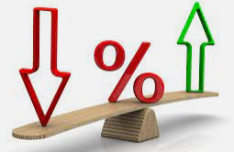


Two types of Government Policy
Summary
Two main methods of intervention:
Fiscal Policy and Monetary Policy
Government can step in to increase AD in two main ways:
Fiscal Policy (FP)
Increases or decreases AD through taxes and government spending.
∆G, ∆ T, ∆ Government Transfers
Monetary Policy (MP)
Increases or decreases AD by changing interest rate.
Lowers or increases the interest rate. (How is this done? We’ll look at this in future chapters.)
When the interest rate is lower, cost of borrowing is lower which has the result that:
  Businesses can invest more (↑I)
  Consumers can purchase interest sensitive things such as houses and cars (↑C)
AD = C + I + G + (X-M)

Slide 27
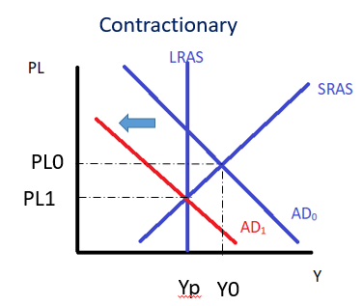
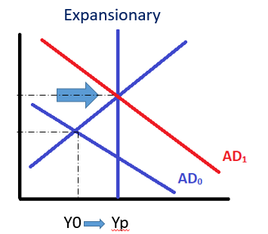
Fiscal Policy Summary
Expansionary = moving AD to the right
Why? To fight a recession and lower unemployment.
Contractionary = moving AD to the left
Why? To fight inflation.
Methods of implementing fiscal policy
  Tax
  Government Spending
    Remember: AD = C+I+G+(X-M)
  Government Transfers (social welfare, food stamps etc.)
    This money will then be spent by households, hopefully at a higher rate than the people being taxed were spending it.
Expansionary
Summary
Fiscal policy = increasing/decreasing AD through taxes (T) and Government spending (G) and government transfers
Expansionary – increase AD
Contractionary – decrease AD

Slide 28
Problems with Economic Intervention
Implementation Lags
Certain fiscal policy often comes with a time lag. Furthermore, even when these laws are passed there can be time before it takes effect. Eg. Building a road (government spending) can take a long time to plan and implement.
Political Lags
In many countries, changes to national tax and government spending policies have to be passed through parliament which can be slowed down by political disagreement.
Time Lags
Data Lags
Most economic indicators are ‘lagging indicators’ in that they give us information about the past rather than future. Therefore, economic data will often have a slight delay in informing us about the economy.
Negative Supply Shocks
We saw that a government can respond to a positive or negative demand shock through fiscal or monetary policy.
How can a government fight a negative supply shock?
Because a negative supply shock causes an increase in price level, a government attempt to increase AD will further increase price level. This is certainly not desirable! The answer is that supply shocks do not have as obvious a solution.
Definition: Fiscal Lag – fiscal policy won’t be implemented immediately because of limitations of data collection, the political process and logistical barriers

Slide 29


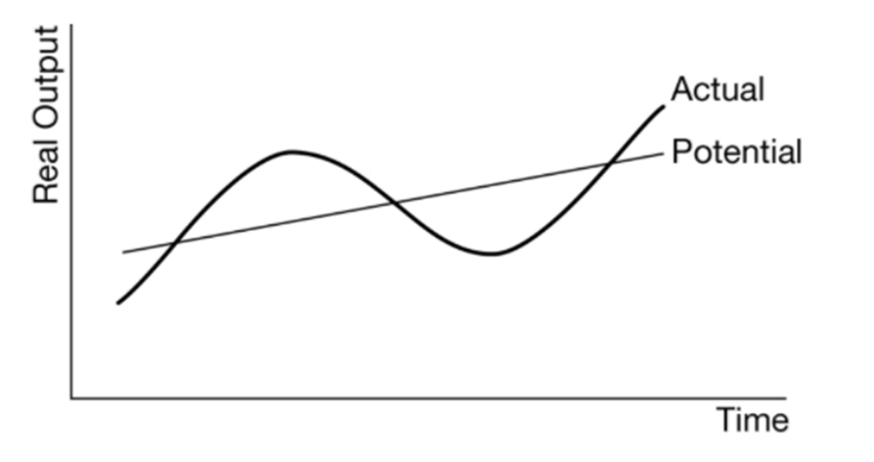
Fiscal Policy
Note: Setting new tax policy is discretionary, however, without any change, the tax rates will operate on their own.
We can split fiscal policy into two main types.
Discretionary Fiscal Spending – choices have to be made by government about what course of action to take. Eg. Building a road, increasing military spending
Automatic stabilizers – fight recessions and ‘economic overheating’ automatically
Eg. taxes, social security (but not lump sum taxes which don’t vary)
Can be referred to as:
Non-discretionary fiscal policy
Automatic stabilizers
The Automatic Stabilizers will ‘smooth’ the business cycle so that the recessions and expansions are less.

Slide 30
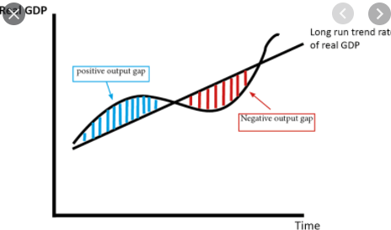
Automatic Stabilizers and the Business Cycle Visualized
Real GDP
Tax and social security payments act as automatic stabilizers for the macro-economy.
In the case of a positive output gap or negative output gap, tax and social security will move counter to the movement of the economy and naturally push us back in the direction of potential output.
Note – the effect of automatic stabilizers is particularly strong when the tax system is progressive, because tax will go up faster when there is a positive output gap, and fall faster when there is a negative output gap.
Positive Output Gap
People earn more money so taxes will go up. (↑T)
Less people are unemployed and so government social security payments (unemployment benefits, food stamps, pensions, disability allowances etc.) will go down. (↓C)
↓AD
Recessionary Gap
People earn less money so taxes will be less (↓T)
More people are unemployed and so government social security payments will go up. This will then be spent by households. (↑C)
↑AD
Summary
Positive Output Gap- the automatic stabilizers will ↓AD
Negative Output Gap – the automatic stabilizers will ↑AD

Slide 31
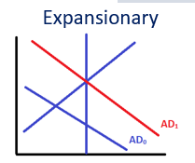
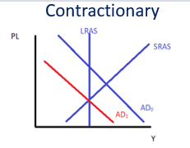
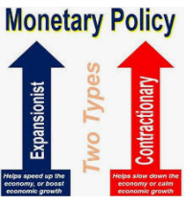
Monetary Policy
Note: The effect on the AD is the same as fiscal policy.
Monetary policy is the other main tool that the government can use to manage the economy.
Simply put it is changing the interest rates. By doing so we can increase or decrease AD.
Lower interest rate – increase AD
What happens when we lower the interest rates?
Consumption (C) increases for interest sensitive products such as houses, cars, tuition etc.
Investment (I) increases because the cost of borrowing is lower
This leads to an increase in AD which can help fight a slowing economy which fights a negative output gap.
Summary
Monetary policy – shifts AD using interest rates.
Fiscal policy – shifts AD using Government spending and tax.
Increase interest rate – decrease AD

Slide 32
Summary: What is Fiscal Policy?
Fiscal Policy
Tax
Government Expenditure
  Government Spending
  Government Transfers
Summary
Fiscal Policy involves tax and government expenditure.
There are two types of fiscal policy – automatic stabilizers and discretionary fiscal policy.
Discretionary Fiscal Policy
Government makes new decisions about government spending and tax. Eg. building a school
Automatic Stabilizers
Government makes no new decisions.
The old tax policy and gov transfer policy will automatically take effect during output gaps.

Slide 33
Spending Multiplier

Slide 34

Marginal Propensity to Consume (MPC)
Marginal = ‘the last dollar’
Propensity = ‘what you usually do’
Consume = buy
Therefore, the marginal propensity to consume is the proportion you spend of your additional income. Ie. How much you spend of the last dollar you received.
We shorten it to MPC.
Summary
The MPC (marginal propensity to consume) is how much you spend of each extra dollar you earn.
Example
If you spend $600 and out of $1000 then your MPC is:
MPC = 600/1000 = 0.6

Slide 35

Marginal Propensity to Save (MPS)
Marginal = ‘the last dollar’
Propensity = ‘what you usually do’
Save = save
Therefore your Marginal Propensity to Save is the proportion you save (MPS)
Summary
MPS (marginal propensity to save) is the amount that one saves of each extra dollar of income.
Example
If you spend $600 then you must save $400 dollars. (Remember we start with $1000.)
Marginal Propensity to Save =
MPS = $400/$1000 = 0.4

Slide 36
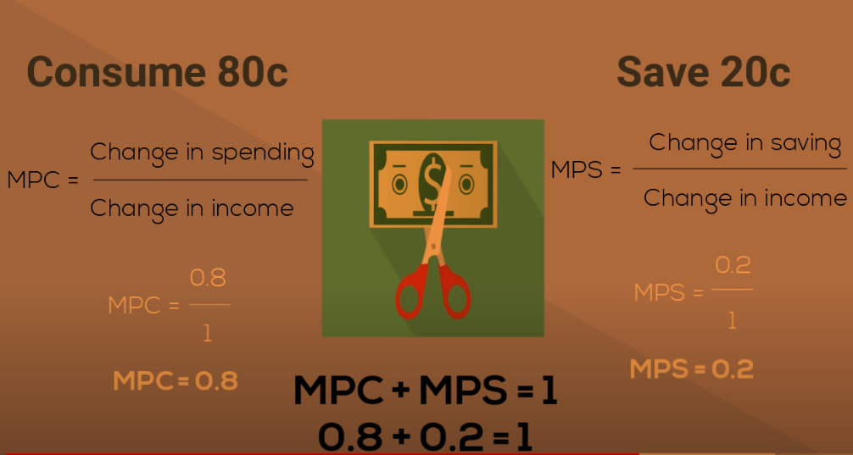

Slide 37

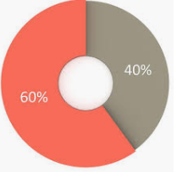



How Money Multiplies
When anyone spends money in the economy, that money will be respent again and again.
So $1 spent creates more than $1 change in the economy’s spending.
  This is the multiplier effect.
Example
You live in a town.
Everyone you know spends 60% of their money and saves 40% of their money.
What is their MPC?
0.6
What is their MPS?
0.4
When you spend 100RMB at KFC, where does it go?
The owner of the business takes the 100RMB.
  His MPC = 0.6 so he spends 60RMB at the grocery store (for example) (and saves 40 RMB)
The owner of Wumart gets the 60RMB and spends 60% of this and saves the rest.
  He spends 60*0.6 = 36RMB to get a haircut.
The barber takes the 36RMB and
  He spends 36*0.6 = 21.6RMB to buy a flower for his wife.
Summary
After money is spent once, it is spent many other times.
These ‘rounds of spending’ sum to the total amount spent.
This is the multiplier effect.

Slide 38
Mathematically
x + ax + a²x + a³ x + a⁴ x + a⁵x + a⁶x + a⁷x + … + a^{n}x
= x . (1 /1-a)
How do we arrive at this? Try asking one of your math teachers!
Eg. 100 + (0.6x 100) + (0.6² x 100) + (0.6³ x 100) + (0.6⁴ x 100) + (0.6⁵ x 100) etc.
= 100 + 60 + 36 + 21.6 etc.
= 100 . (1/(1-0.6)
= 250

Slide 39



The Multiplier Formula Conclusion
The limit part of the calculation, called the multiplier is given by:
Remember that MPC + MPS = 1
Conclusion: Our original $100 creates $250 of total spending.
This is why we call it the money multiplier. Because the original amount of money multiplies in the economy.
We times the multiplier by the original money spent.
Total Spending (Total Change in GDP) =
  = Original spending x Multiplier
  = Original spending x 1/(1-MPC)
In our example:
Multiplier = (1/(1-0.6) = 2.5
Total Spending = 100 x 2.5
= 250

Slide 40
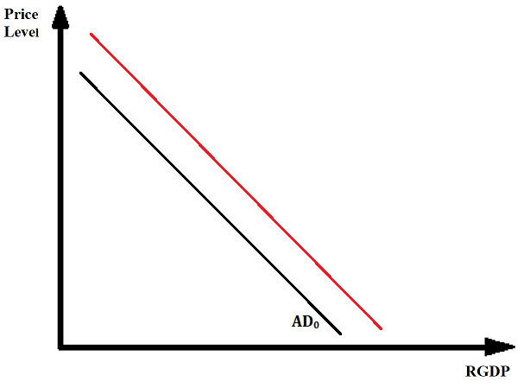
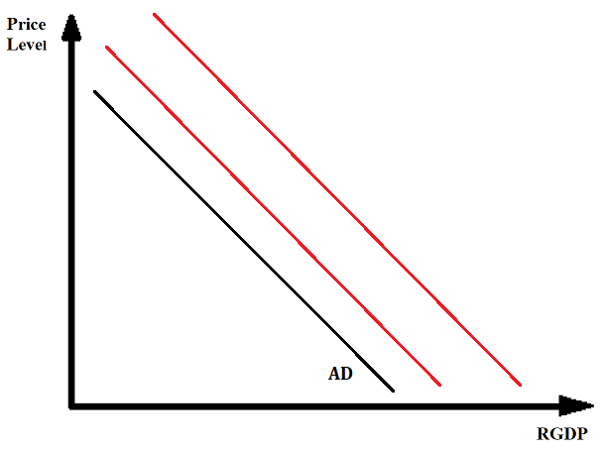
Spending Multiplier Effects
Summary
All types of spending will have a multiplier effect.
The total effect on AD is larger than the initial effect.
All spending in the economy has a multiplier effect.
Consumption
Investment
Initial effect on AD
Government Spending
Final effect on AD with the multiplier effect
Exports - Imports
Note: Exports = positive effect, Imports = negative effect (leakage)

Slide 41
Government Multipliers
Summary
Gov spending multiplier > Gov tax multiplier
Gov can increase GDP by taxing then spending
Government Spending
Government Taxation
Government Spending Multiplier = 1/(1-MPC)
Government Taxation Multiplier = -MPC x 1/(1-MPC)
Spending multiplier = Positive
>
Tax multiplier = Negative
One thing to note, is that the Government spending multiplier is larger than the Government Tax multiplier.
Therefore the government can increase the total expenditure = GDP even if the taxes are the same size as government spending.
Of course, in the real world it isn’t always that simple and the multiplier can be much smaller than anticipated, especially in a recession when confidence is low.

Slide 42
Example – Government Spending and Tax are equal
Summary
Tax multiplier < Spending Multiplier
If tax and government spending changes by the same amount, AD will still increase.
Government spends an extra $100 million.
Government increases tax by $100 million. MPC = 0.8
Will AD increase, decrease or remain the same?
Increase
Gov Spending
∆GDP= ∆Gov Spending x Spending Multiplier
= 100 x 1/(1-0.8) = $ 500 million
Gov Tax
∆GDP= ∆Tax x Tax Multiplier
= ∆Tax x (-MPC x 1/(1-MPC))
= 100 x -0.8 x 1 / (1-0.8)
= 100 x -4
= - $ 400 million
The spending multiplier is larger than the tax multiplier.
↑Spending, ↑AD

Slide 43
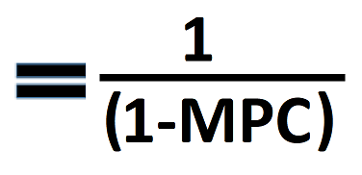
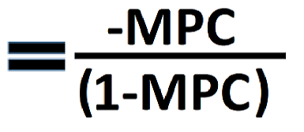
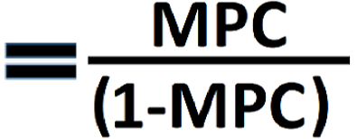
Multiplier Equations Summary
MPC = Marginal Propensity to Consume = ∆Consumption / ∆Disposable Income
MPS = Marginal Propensity to Save = ∆Saving / ∆Disposable Income
MPC + MPS = 1
Disposable Income (Y_{D}) = Income - Taxes
Spending Multiplier
Government Tax Multiplier
Government Transfer Multiplier
Or 1/MPS
Or -MPC/MPS
Or MPC/MPS
Government spending and tax at the same time.
∆GDP = ∆Income = ∆G x Multiplier + ∆Tax x Tax Multiplier
If the ∆Tax = ∆G, then AD will increase because spending multiplier is larger than tax multiplier.
Effect on Economy:
∆AD = ∆GDP = ∆Income = ∆Initial Spending x Multiplier
∆AD = ∆GDP = ∆Income = ∆Tax x Tax Multiplier
∆AD = ∆GDP = ∆Income = ∆Transfer Payment x Transfer Payment Multiplier

Slide 44
Lump Sum Taxes
Summary
Lump sum taxes have no effect on the question that you answer because they don’t affect decision making.
They simplify the question.
In some of these questions we will see the term lump sum taxes.
This is a quite theoretical tax that only really exists in economics questions.
A lump sum tax is one that everyone pays the same amount, regardless of their income or what they buy or anything other characteristic.
  It is independent of any other factors that we might need to consider.
  Therefore, it DOES NOT affect the behavior of people in any more complex way.
  This essentially means that the lump sum tax is a ‘nothing tax’.
    It doesn’t affect the question in other ways
    It simplifies the question because we don’t have to think about the effect of more complex taxes
    Lump sum taxes are our friend because they make the question more simple

Slide 45
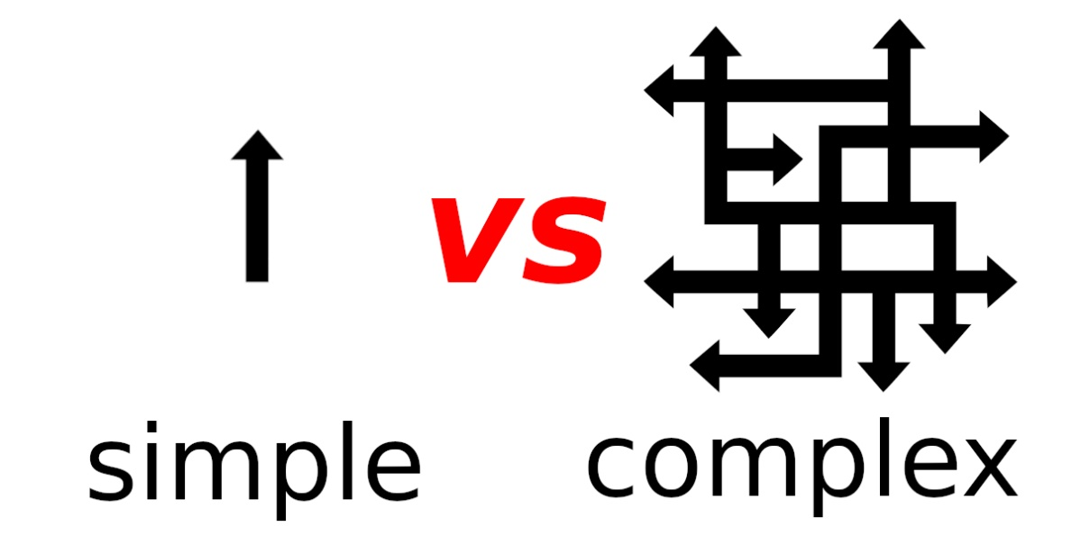
Autonomous Consumption, Autonomous Investment etc.
Summary
The word ‘autonomous’ actually simplifies the questions that we see.
It means independent, and not affected by other factors – we don’t need to worry about how other variables affect this.
The word ‘autonomous’ appears in some questions but we can actually treat autonomous investment as just investment.
It means not affected by factors within our model. This means we don’t have to think about how extra things that will affect it.
Just like with the term ‘lump sum taxes’ it is actually designed to make the question more simple.
So you can treat it ‘autonomous investment’ the same was as investment.
Autonomous investment – not affected by outside variables
Investment – could be affected by many variables

Slide 46
Simplified vs Full Circular Flow Model
Full Model Multiplier
Simplified Multiplier
MPC (Marg. Prop. to consume)
MPS (Marg. Prop. to save)
Multiplier = 1/MPS or 1/(1-MPC)
MPC (Marg. Prop. to consume)
MPS (Marg. Prop. to save)
MPT (Marg. Prop. to pay tax)
MPM (Marg. Prop. to import)
Multiplier = 1/(MPS+MPT+MPM) or 1/(1-MPC)
The multiplier will be smaller because there will be less consumption in the economy (due to paying taxes and spending on imports)
Note: Even though the assumptions are different, the multiplier formula is still the same:
Multiplier = 1/(1-MPC)
Note:
You most likely don’t have to worry about the difference between the two because Multiplier = 1/(1-MPC) which is the same for both.

Slide 47
Multiplier Summary
  Multiplier: Remember that the more people spend in the economy the larger the multiplier will be! Person A’s Spending = Person B’s Income, Person B’s Spending = Person C’s Income etc.
  ∆GDP= ∆Spending x Multiplier
Simplified multiplier = 1/MPS = 1/(1-MPC)
  MPC = Marginal propensity to consume, MPS = Marginal propensity to save
  MPC + MPS = 1
  Applies to Consumption, Investment, Government Spending and Exports
Government Tax multiplier = -MPC/(1-MPC)
  (Note: the tax multiplier is negative because it’s a leakage)
  Tax Multiplier < Spending Multiplier
∆GDP= ∆Spending x Multiplier
Bonus: Full multiplier = 1/(MPS+MPT+MPM) = 1(1-MPC)
  MPT = Marginal propensity to pay tax
  MPM = Marginal propensity to import goods

Slide 48
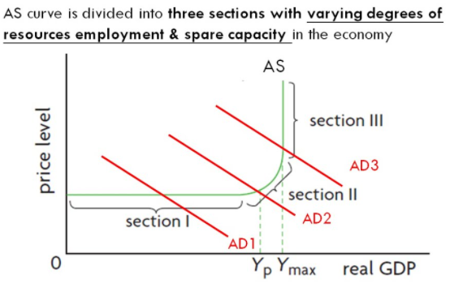
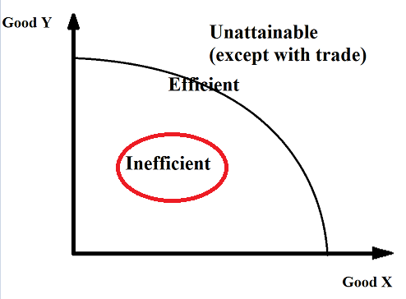
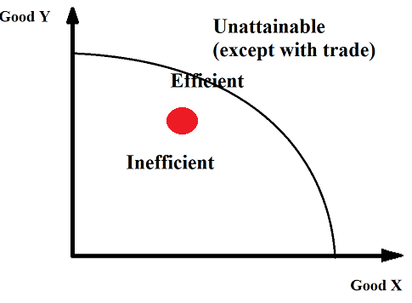
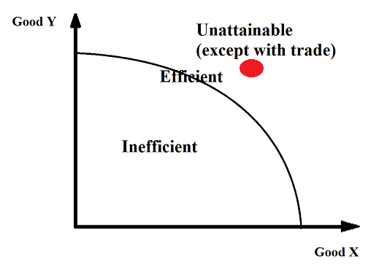


Keynesian Aggregate Supply Curve
Summary
Keynes was in favor of fiscal policy by governments when the economy went into recession.
This was driven by his view on the Aggregate Supply Curve.
Spare Capacity (Section 1)
One of the reasons for this was that economy’s have ‘spare capacity’ when output falls to a certain level.
  Spare capacity means that in a recession, many resources are idle, and the economy can increase output significantly if demand increases.
This results in the SRAS being very flat, over the range that would be associated with a recession. It is sometimes called the ‘Keynesian range’.
Scarcity (Section 3)
While we have seen that there is a positive relationship between price level and output in the short run, Keynes believed that we inevitably reach a limit as resources become more scarce.
This results in the AS being vertical in the positive output gap range.
This is the classical view of supply, so this section is sometimes called the ‘classical range’.
Intermediate Range (Section 2)
Over this range resources are becoming more scarce, but the sticky wages still create an upward slope.

Slide 49
Fiscal Policy and the Keynesian Supply Curve
If we assume the Keynesian supply curve, we can see that when AD is low, the economy will likely enter a recession.
Therefore, expansionary fiscal policy will be very effective if we are in the horizontal part of the AS curve.
Summary
If we are on the flat part of the Keynesian supply curve, expansionary fiscal policy will be very effective.

Slide 50

Draw the Keynesian Aggregate Supply Curve.
Label the three sections.

